Slide 1
ECA Registry – EBSI integration
Testing guidelines
Mirko Iaconisi
v.1.1

Slide 2
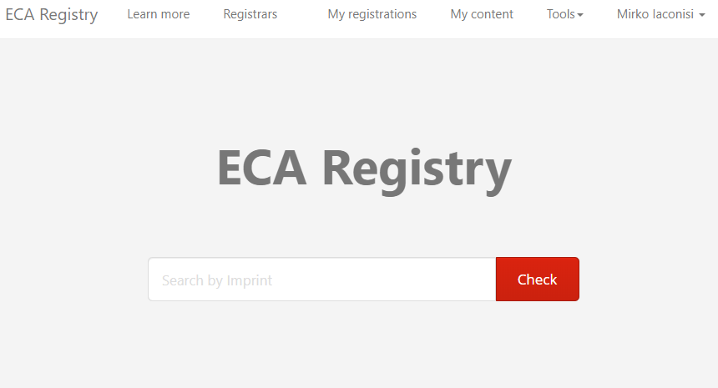
Access to the application
The ECA Registry is available at the URL: https://registry.eca.europa.eu
You can register your identity(s) at https://registry.eca.europa.eu/register
4. For support, you can contact
mirko.iaconisi@eca.europa.eu and
denis@compell.io

Slide 3
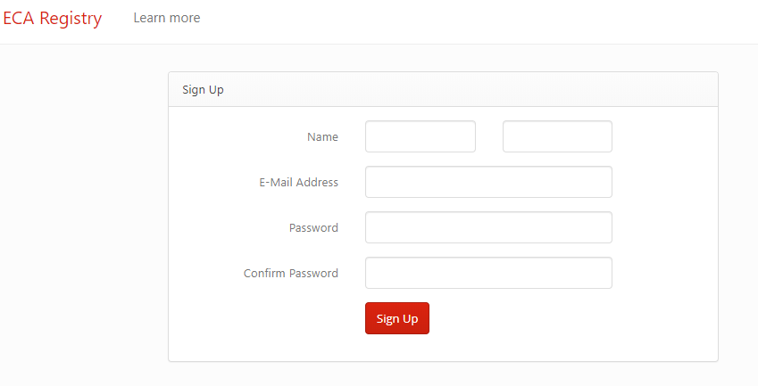
Registration of a new identity
1. Connect to:
2. Fill in the form
3. Press sign up
4. Login with your new credentials
5. The identity will be notarised on chain
https://registry.eca.europa.eu/register

Slide 4
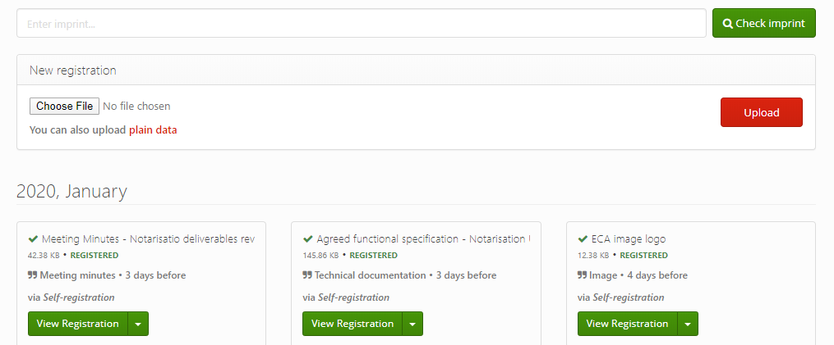
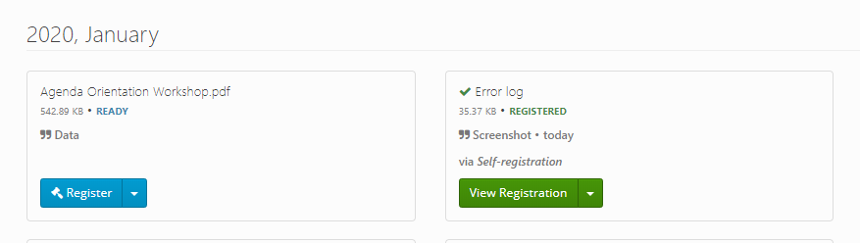
Notarisation of a document (1/3)
1. Select “My content” from the top right menu
2. In the section “New registration” select the file to notarise and press upload
3. The file appears in the list of contents, with a blue button, ready to be notarised
4. Click on the button “Register”

Slide 5
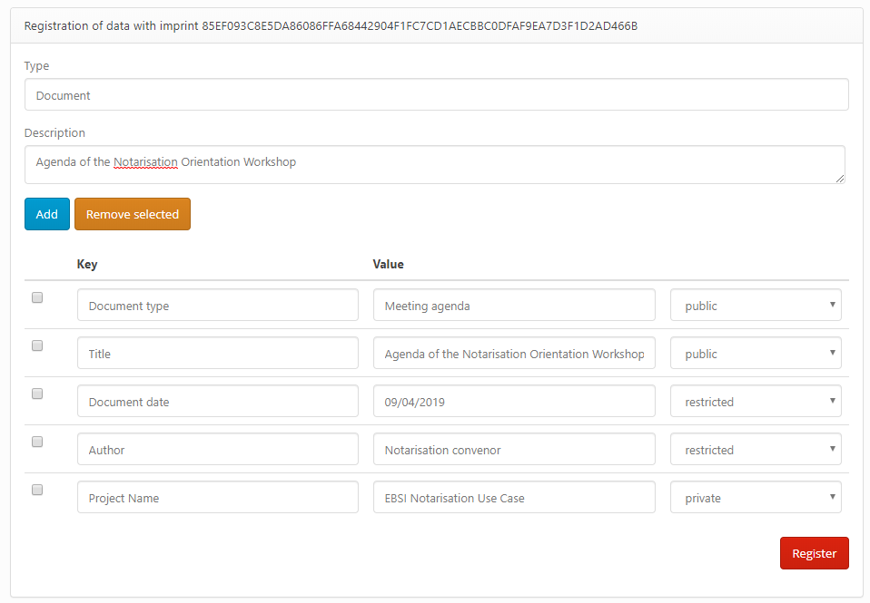
Notarisation of a document (2/3)
5. Specify the data type (e.g. Document)
6. Fill in a description to be shown in the interface
7. Insert as many metadata as needed with the “Add” buton and fill them in, setting as well the level of visibility
8. Click on the button “Register” to proceed with the notarisation

Slide 6
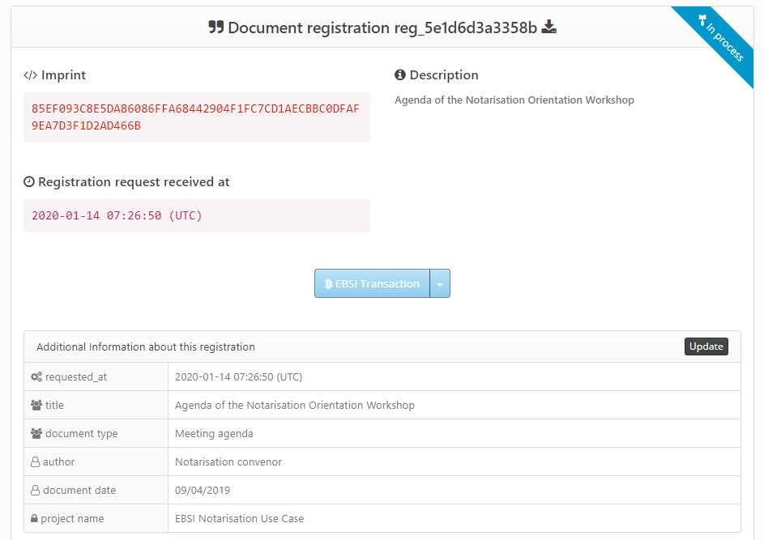
Notarisation of a document (3/3)
9. The registration will appear “In process” until the EBSI transaction is confirmed
10. The button EBSI Transaction will become clickable after the confirmation is received
11. Refresh the page after one minute (or access it again from the homepage) to verify the status change to “Registered”
12. There is a download button (highlighted in red) that allows to retrieve the document from the storage

Slide 7
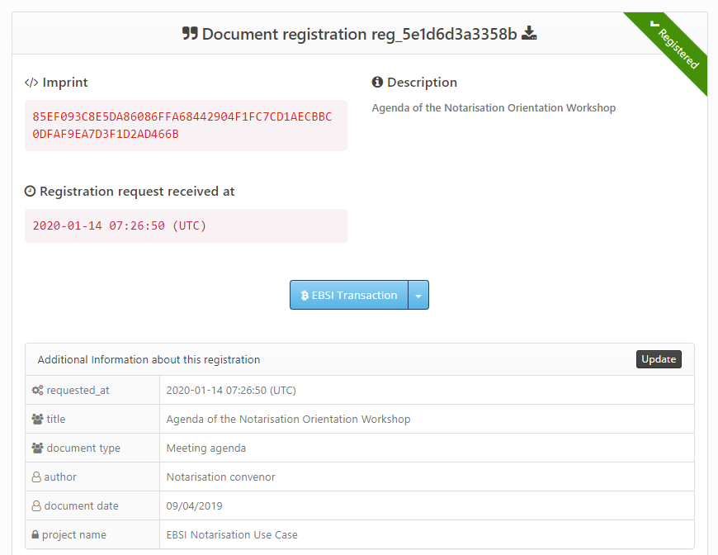
Visualisation of a notarisation
Download document
Status
Hash of the document
Registration ID
Timestamp
Access to the blockchain transaction
Metadata

Slide 8
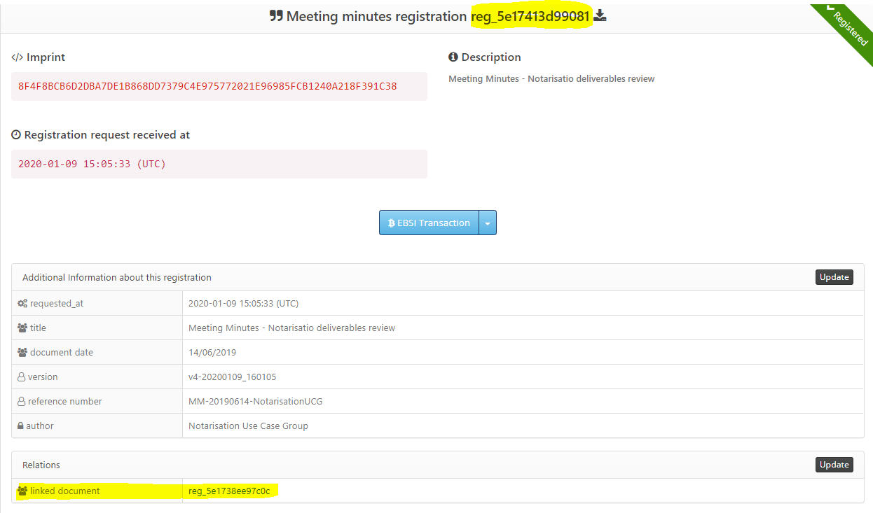
Linking notarisations (logical chain)
To link a specific to notarisation to a previous one, you can add its Registration ID as a value among the metadata (see metadata input in slide 5)
The Registration ID can be found on top of the visualisation page (see screenshot in this slide)
When the Registration ID of a previous notarisation is added as metadata, it will be shown (after the submission) as a relation and it will have a clickable direct link to the related registration
Registration ID of the current notarisation
Reference to a previous notarisation that has been linked to the current one
(clickable link)

Slide 9
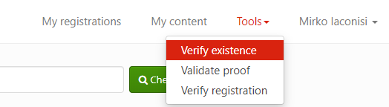
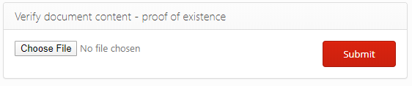

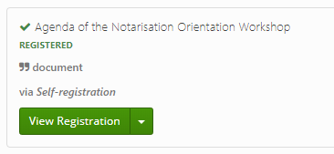
Verifying a document notarisation
1. Select “Verify existence” from the Tools menu
2. Select the file that must be verified and submit it
3. If the hash of the file is not known to the registry, it will return “No registrations found” or else it will return the notarisation data
No notarisations found
There is already a notarisation for the given document

Slide 10
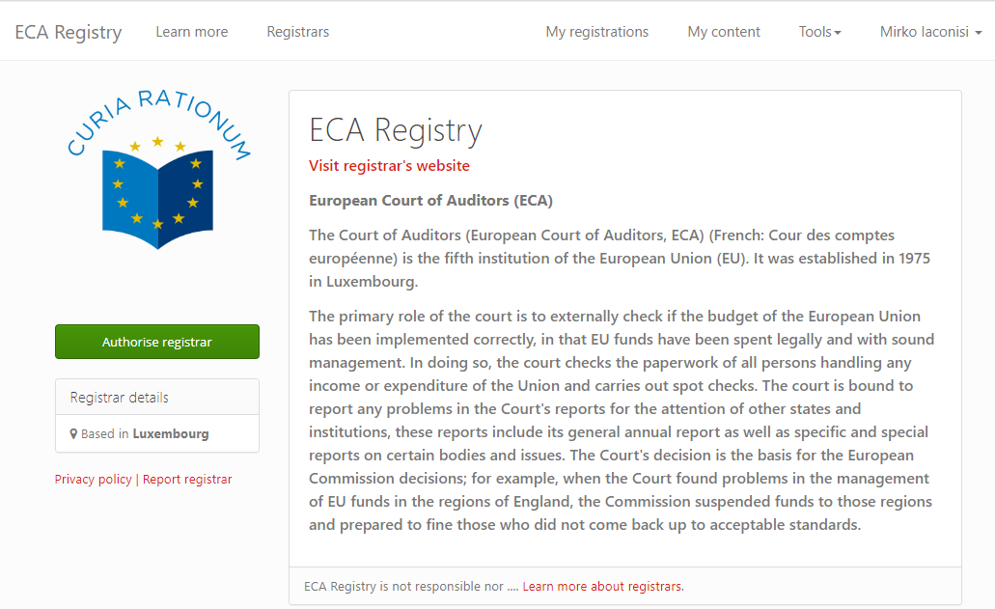
Authorising a Registrar
1. Go to the section Registrars
2. Select a Registrar from the list on the right side (contact denis@compell.io to create a new registrar, e.g. an institution, company…etc.)
3. Click on “Authorise Registrar”
4. From now on the Registrar can notarisations on behalf of the current user and see its notarisations

Slide 11
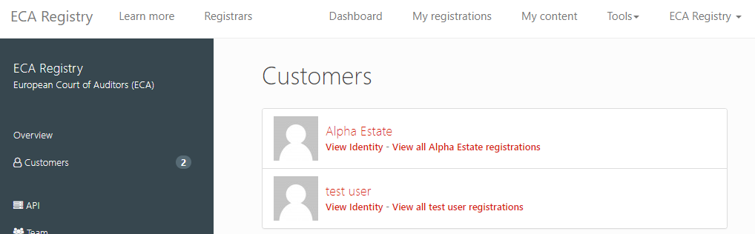
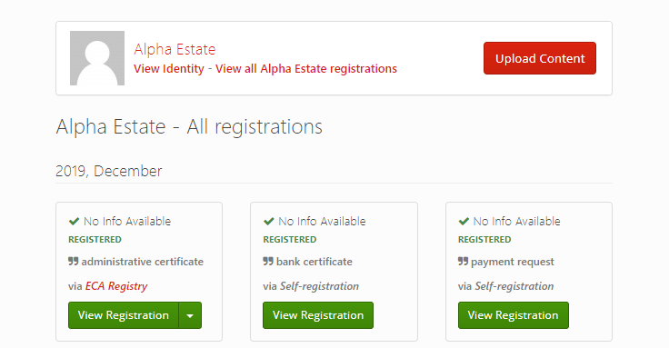
Registrar’s dashboard
1
A Registrar can see all the notarisations done by the users that gave their consent.
This is visible in the Dashboard → Customers → View all registrations for a certain user
A Registrar can also notarise on behalf of theses users.
3
2
Notarise on behalf of the user
View all the notarisation (done by the Registrar or by the user itself)

Slide 12
Feedback / Questions
You can address your feedback and questions to:
mirko.iaconisi@eca.europa.eu and denis@compell.io

